Slide 1
Proposing XAMERA Desktop
Deniz K. Acikbas – 10.24.2024

Slide 2
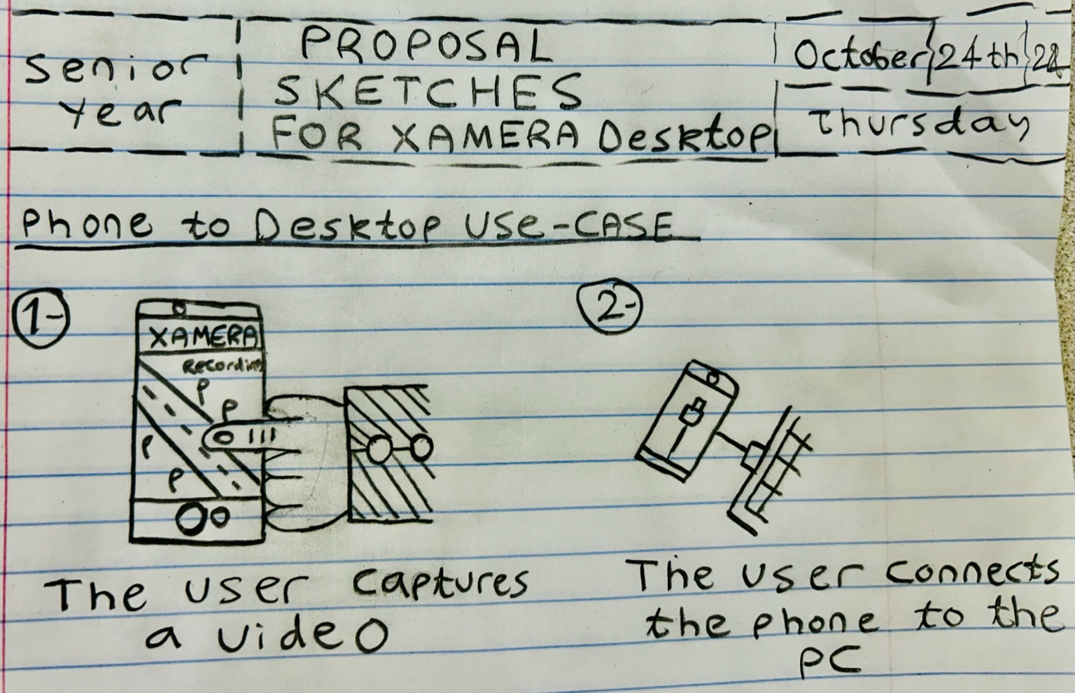

Slide 3
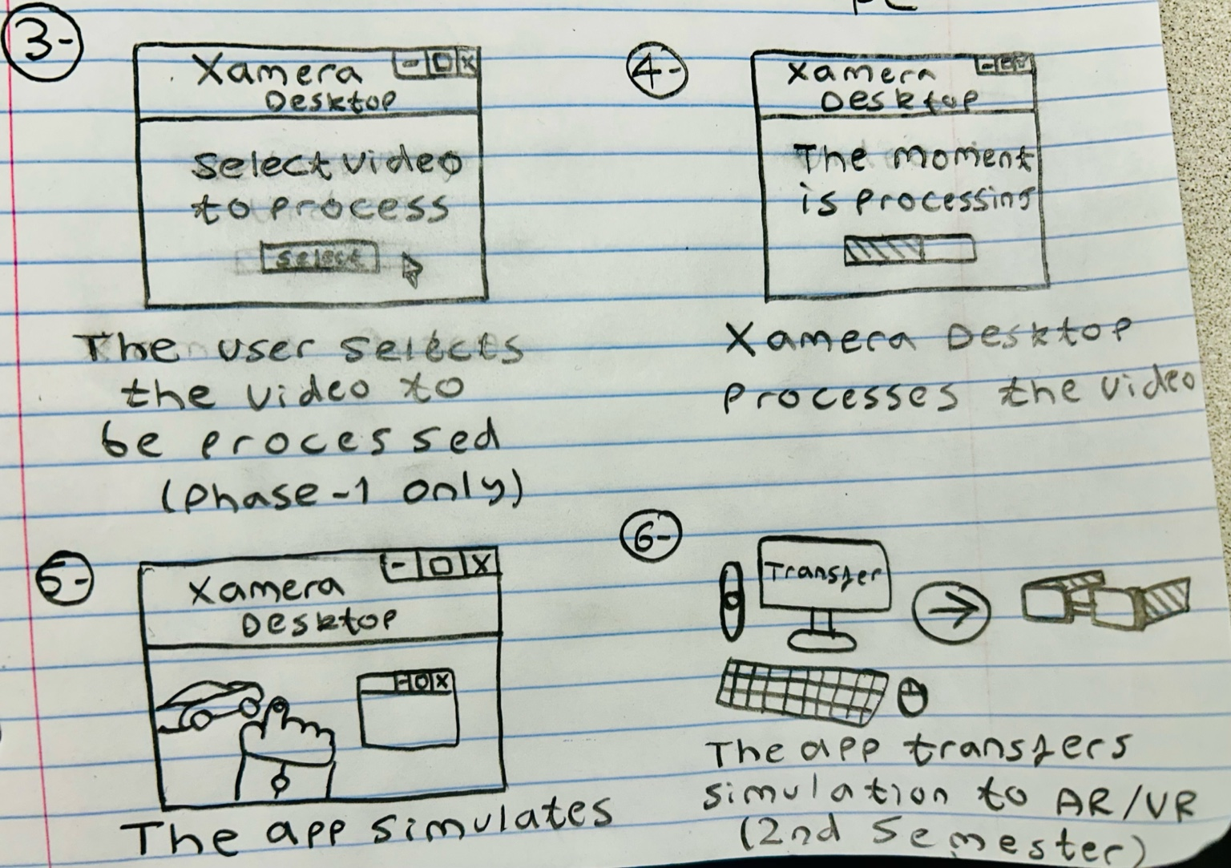

Slide 4
Why Xamera desktop was needed?
Implementing image processing, machine learning algorithm, smooth gesturing simulations on one Android app can delay the release of the prototype.
Most of the algorithms for image processing, machine learning algorithm, smooth gesturing were developed in PC (easier to integrate with a desktop app).
Easier to simulate on AR/VR using a PC than smartphone
Only one person in team has experience with Android Studio (limited experience)

Slide 5
Is Xamera desktop a viable project?
Yes, it is! Xamera Desktop can be implemented with the following technologies below;
.NET Framework with Windows Forms (Experienced since 2021)
3rd Party Libraries that support multiple programming language compilers (such as Python)
Inner app processing (The desktop app can trigger other programs in the background until the process has been done)

Slide 6
Can this project finish on time?
Yes, it can! It may even finish faster than before December 2024. Here are the expected deadlines;
Early November: The user will be able to plug the phone, select a video and have it processed by Xamera Desktop.
Mid November – Late November: The user can use their phone as a live camera and Xamera Desktop will automatically process the moment while the phone was plugged in.
December: Last adjustments to Xamera Desktop and Testing.

Slide 7
Thank you for listening (Q & A Time)

